Slide 1
FIFTEEN PUZZLE GAME
Group Leader:Zhiqiang Weng

Slide 2
Problem Faced
Position x and y for the background picture
Dynamically generate element and give id
Set onclick attribute to each id
Simple mistake causing whole function not working
Randomly generate solvable array
Compare id and change content

Slide 3
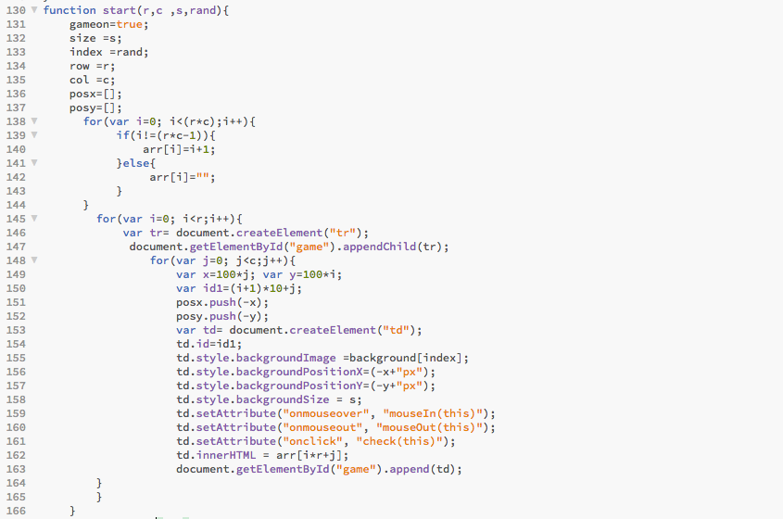
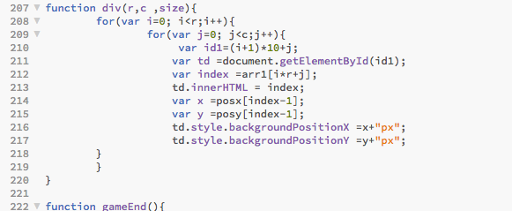
Code Snippet (generate & update game )

Slide 4
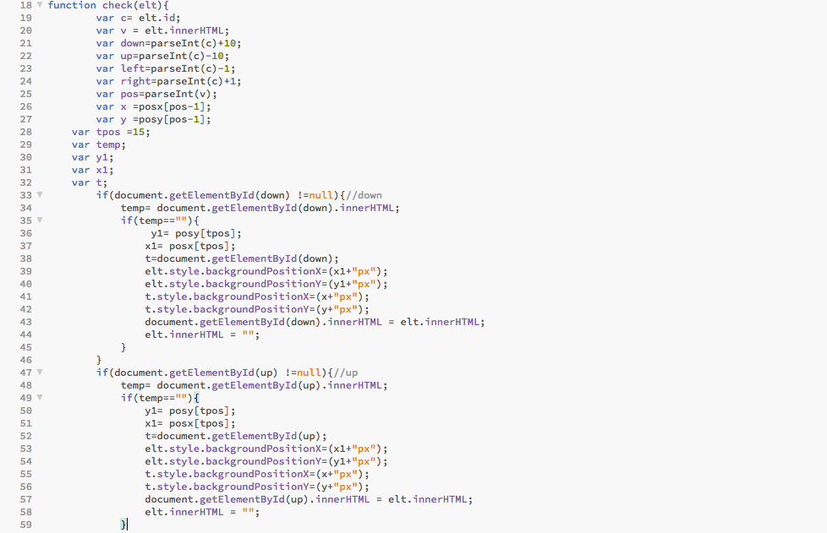
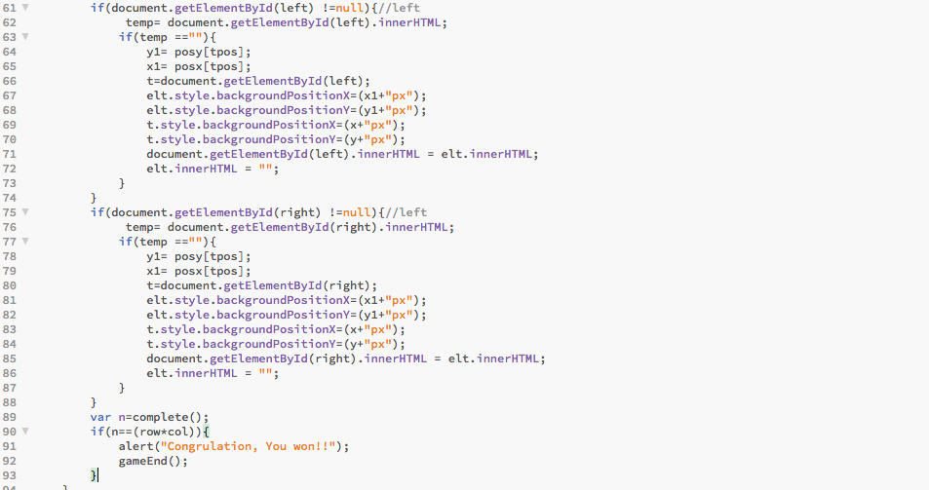
Code Snippet (check element can be move)

Slide 5
Time Consumption & Extra Feature
Spending about 35 hours
1. End game notification.(click endgame Button)
2. Game time.
3. Multiple Background Picture
4. Different puzzle size

